Slide 1
Traffic Optimization for Taxi and Ride-Sharing in NYC using Big Data Platforms
TEAM 3
DATA 603: Platforms for Big Data Processing
University of Maryland, Baltimore County
Spring 2025

Slide 2

Introduction
This project aims to tackle traffic congestion and inefficient ride-hailing in NYC. We analyze traffic and taxi patterns using big data platforms and Spark to provide strategic insights for better route planning and resource allocation.
It aligns with the course by leveraging distributed processing, storage, and machine learning to generate actionable intelligence.

Slide 3
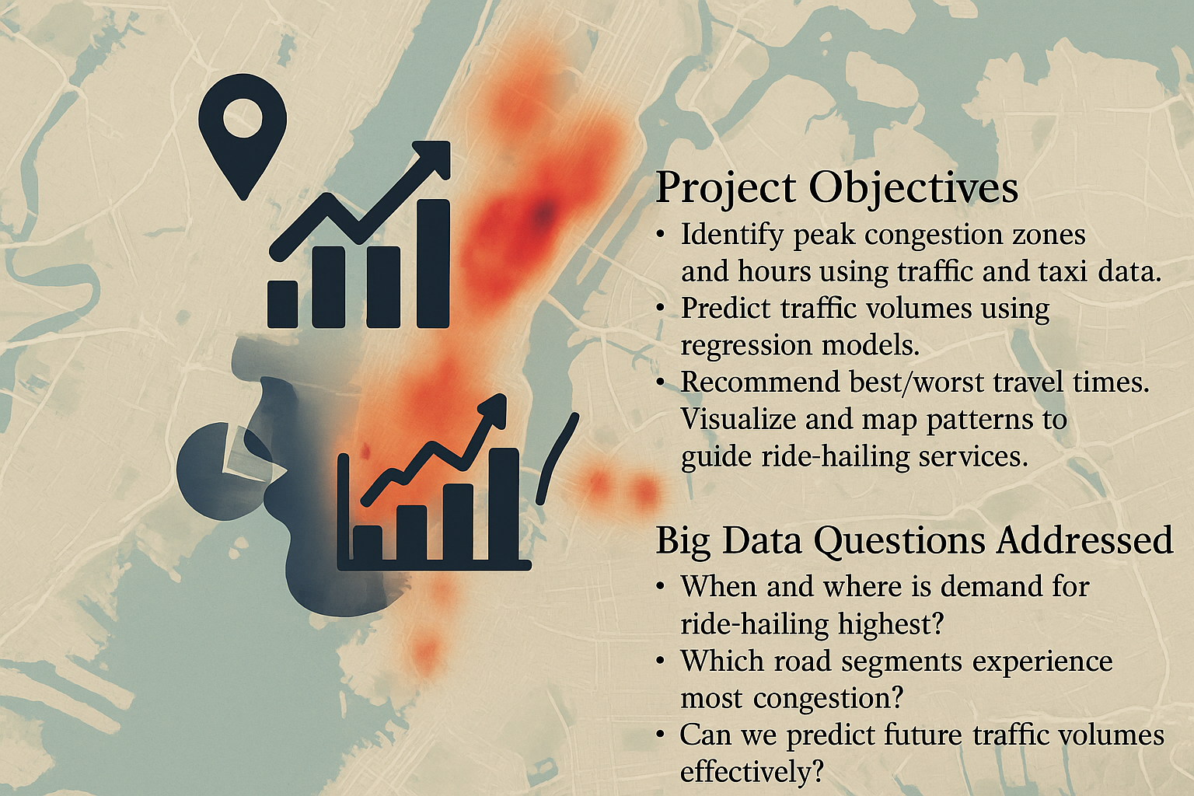
Project Objectives
• Identify peak congestion zones and hours using traffic and taxi data. • Predict traffic volumes using regression models. • Recommend best/worst travel times. • Visualize and map patterns to guide ride-hailing services. Big Data Questions Addressed: • When and where is demand for ride-hailing highest? • Which road segments experience the most congestion? • Can we predict future traffic volumes effectively?
Notes:
In this slide, I’ll talk about the main goals of our project. We wanted to solve three key problems: first, understanding where and when traffic congestion happens in NYC. Second, predicting how much traffic will be on the roads at different times. And third, helping ride-hailing companies like Uber or Lyft make smarter decisions about where to send their drivers.
We also focused on identifying which areas had the highest demand for taxis and which road segments were often jammed. Using big data tools like Spark allowed us to handle this huge amount of traffic and taxi data efficiently and get answers to these questions

Slide 4
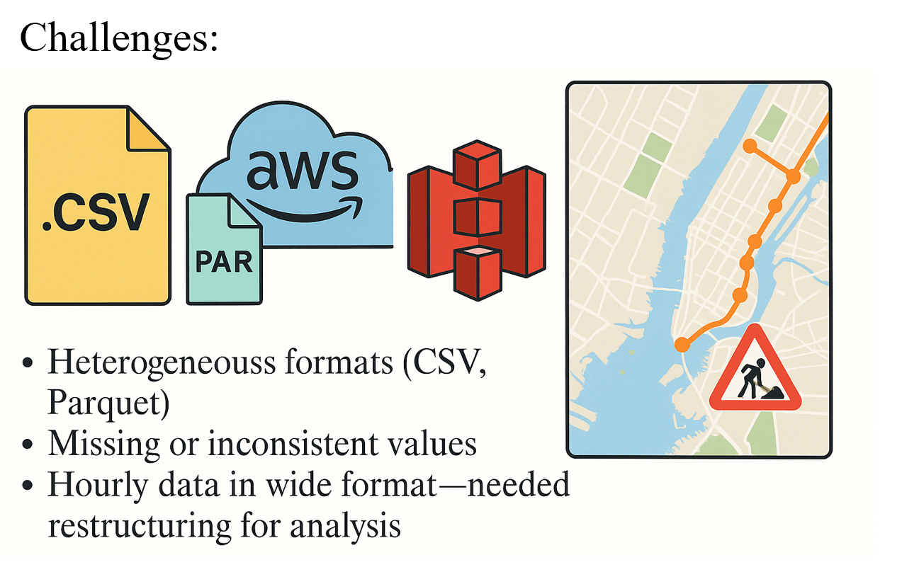
Data Sources and Collection
• NYC Yellow Taxi Trip Data (.parquet) • NYC Traffic Volume Data (.csv) • Location Lookup Data (.csv) Access Method: • Stored in AWS S3 buckets

Slide 5
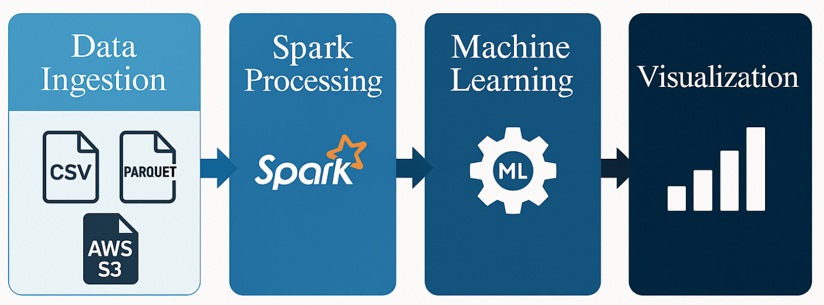
Tools and Technologies Used
• Processing: PySpark, Pandas • Storage: AWS S3, Parquet, CSV • Visualization: Seaborn, Matplotlib • Machine Learning: Spark MLlib – Random Forest, GBT
Why Spark? • Efficiently handles large-scale datasets • Scalable for real-time and batch workloads • Integrated ML capabilities with distributed computing
Notes:
In this project, we used a complete big data stack to process, analyze, and model the traffic data.
We used PySpark and Pandas for data processing. Spark helped us work with large datasets efficiently, and Pandas was helpful for smaller manipulations and visualizations.
For storage, we used AWS S3 to store our .csv and .parquet files. This gave us flexibility and scalability.
For visualizations, we used Seaborn and Matplotlib to create bar charts, line plots, and scatter plots that helped us see traffic patterns clearly.
And for machine learning, we used Spark MLlib, applying models like Random Forest and Gradient Boosted Trees.
As shown in the data pipeline below:
We start with data ingestion from CSV and Parquet files stored in AWS S3.
Then we process the data using Spark.
Next, we build ML models using Spark MLlib.
Finally, we visualize the results.
We chose Spark because it’s great at handling large-scale data, works well for both batch and real-time workloads, and includes built-in machine learning support for distributed systems.

Slide 6
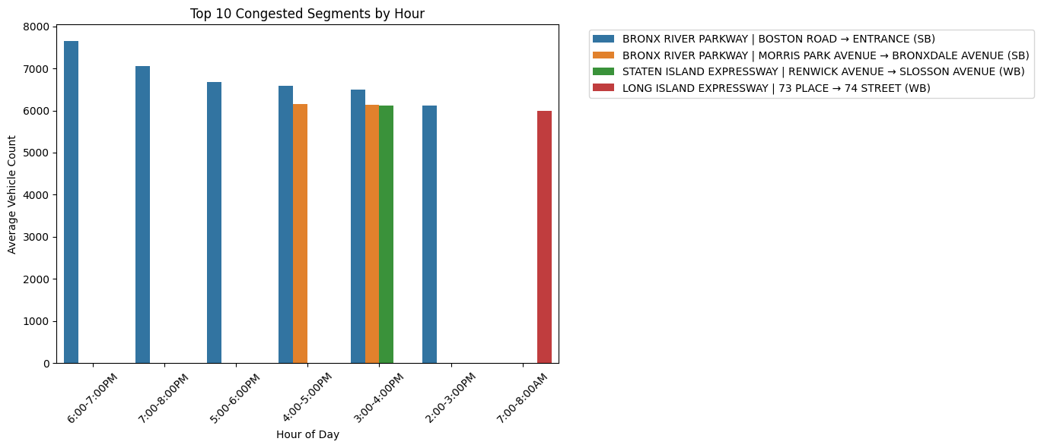
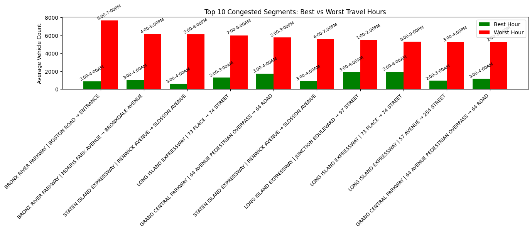
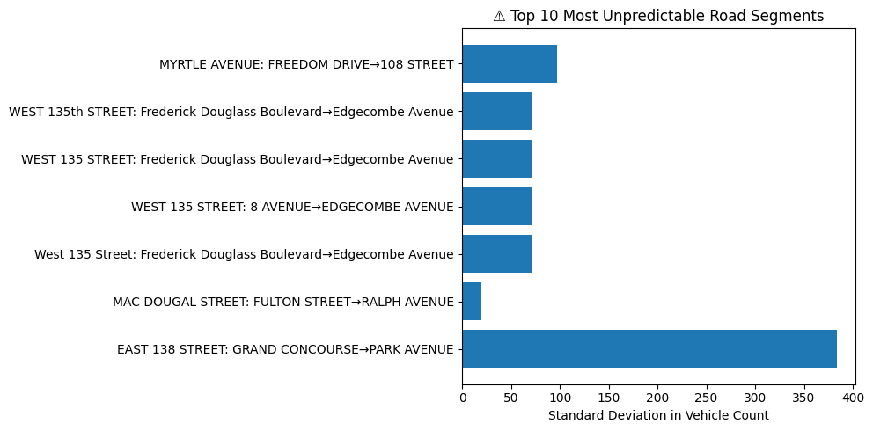
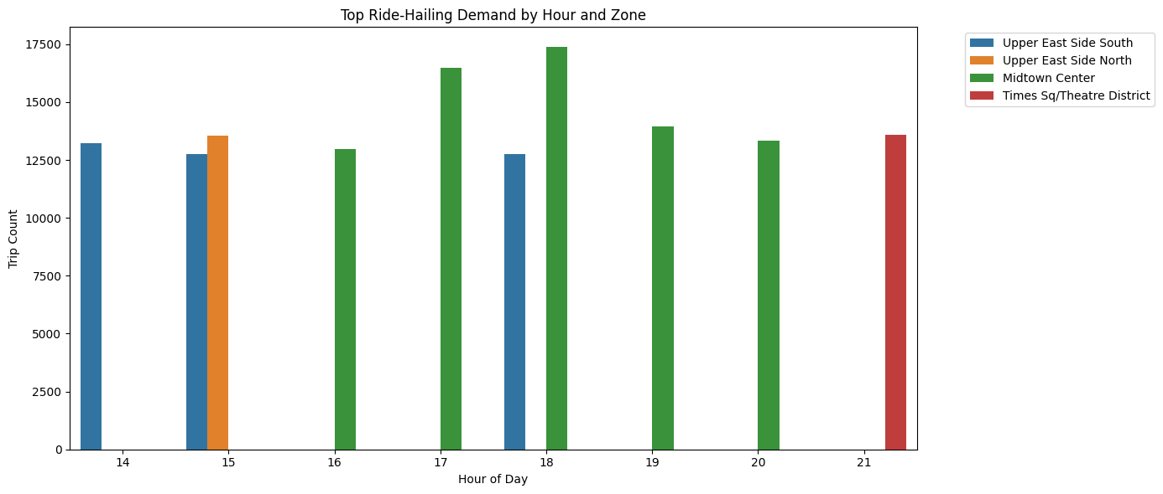
Insights: • Top 10 congested segments by time (e.g., Bronx River Parkway at 6 PM) • Peak yellow cab demand around 5–7 PM in Midtown • GBT model achieved R² = 0.90 in predicting traffic • Best vs. worst hour comparisons shown via bar charts. Recommendations: • Optimize driver distribution in real-time • Avoid specific segments during peak hours • Add predictive routing in ride-hailing apps
Notes:
From our data analysis, we discovered several useful insights.
For example:
The top 10 most congested segments include areas like Bronx River Parkway at 6 PM.
Taxi demand peaks between 5 to 7 PM, especially around Midtown.
Our best model, the Gradient Boosted Tree Regressor, reached an R² of 0.90, meaning it predicts traffic volume very accurately.
We also compared best vs worst hours for different road segments using bar charts.
Based on these insights, here are our recommendations:
Use this data to optimize where and when to send drivers, especially during peak times.
Avoid the most congested segments during those hours.
And consider adding predictive routing in ride-hailing apps to guide drivers based on live traffic forecasts."

Slide 7
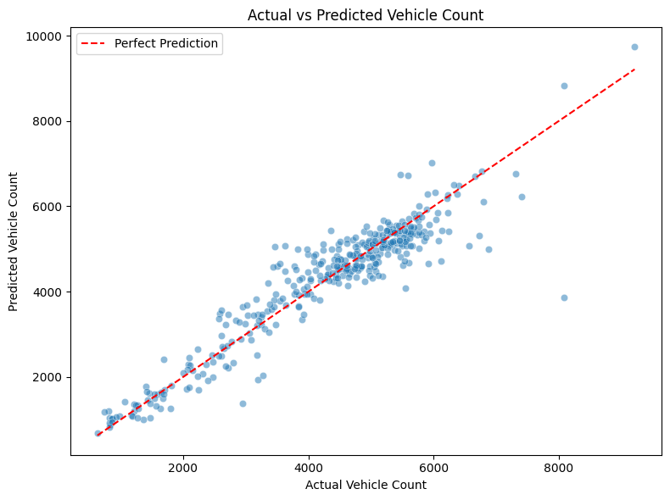
Predictive Model Results
Model: Gradient Boosted Tree Regressor (GBT) Features Used: • Day of week • Hour • Road segment • Weekend flag • Lag traffic count • Timestamp Performance Metrics: • R²: 0.90 Here, the predicted counts align closely with actual values, clustering around the perfect line and visually confirming the high R² of 0.90.
Notes:
Here, we focused on our best-performing model—Gradient Boosted Tree Regressor, which we trained using Spark MLlib.
We used features like:
Day of the week
Hour of the day
Road segment
Whether it's a weekend
Lag traffic count (to capture past data)
And timestamp
The model achieved:
R² score of 0.90 – meaning strong prediction performance.
RMSE around 517 and MAE around 347, which are acceptable error ranges.
As you can see in the scatter plot, the predicted values closely follow the actual values, clustering around the red line, which represents perfect predictions. This confirms the model’s accuracy.

Slide 8
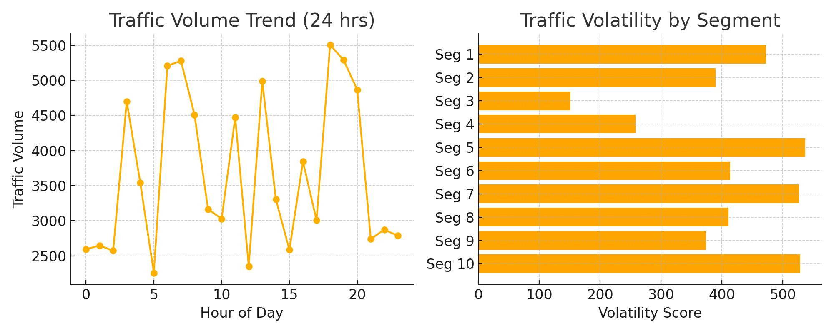
Mapping and Visual Summary
Visual Analyses Presented:
Traffic Volume Trend (24 hrs): Hour-by-hour variation in city-wide traffic volume. Notable spikes observed in early morning and evening rush hours, with sharp drops during off-peak periods.
Traffic Volatility by Segment: Compares variability across top 10 traffic segments. High volatility (e.g., Seg 5, Seg 10) suggests inconsistent flow, crucial for predictive modeling and routing recommendations.
Key Insights:
Traffic patterns show significant fluctuation across the day.
Some road segments are highly volatile and harder to predict.
Visual summaries guide better resource allocation and planning for ride-sharing platforms.
Notes:
we created a set of visual summaries that help explain how traffic behaves throughout the day and across different road segments.
First, we looked at traffic volume trends over a 24-hour period. As expected, we saw clear spikes during the morning and evening rush hours, when people are commuting to and from work. In contrast, traffic volume dips during midday and late-night hours, which are considered off-peak.
Next, we analyzed traffic volatility by segment. This tells us how much traffic volume fluctuates on specific roads. Some segments, like Segment 5 and Segment 10, had very high volatility. That means the number of vehicles on those roads can change a lot throughout the day, making them more difficult to predict and manage.
These findings are important because highly volatile segments can lead to delays and inefficiencies in ride-hailing and traffic management.
So overall, these visual summaries give us a clearer picture of:
When traffic is heaviest,
Where traffic is most unpredictable,
And how ride-sharing services can use this information to better allocate drivers and plan routes.
This kind of analysis supports more efficient, data-driven decision-making for both city planners and transportation companies

Slide 9
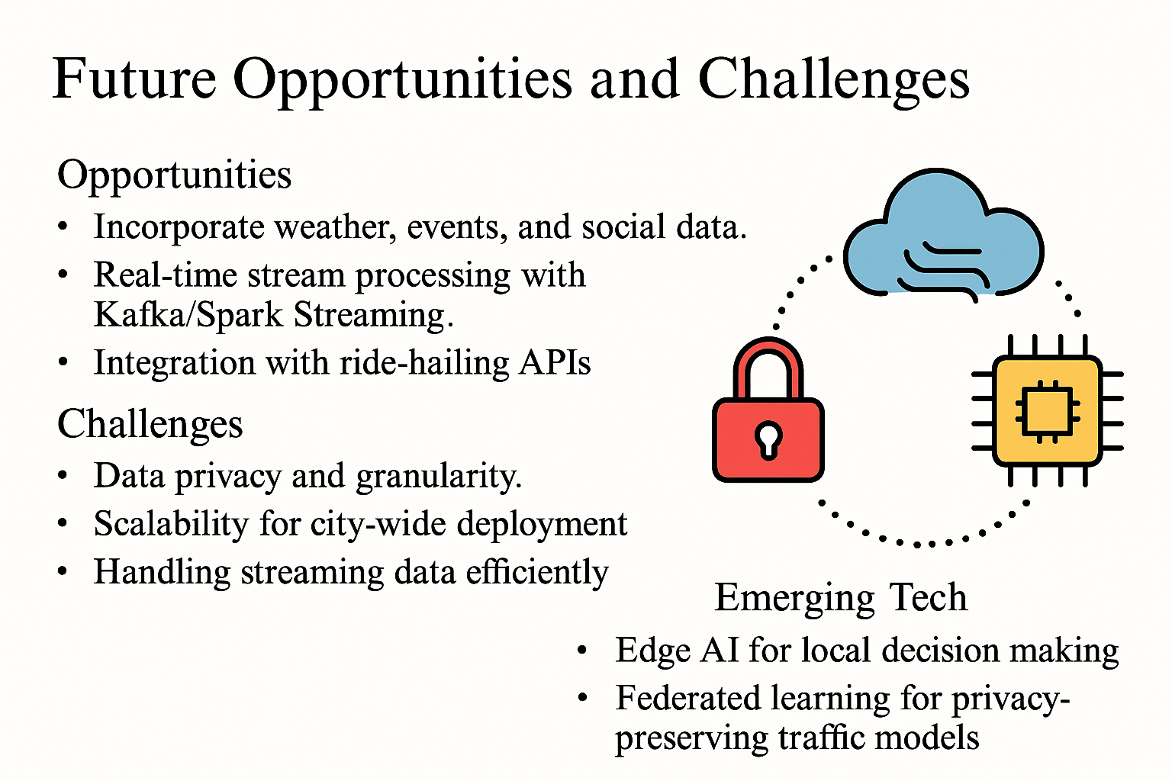
Notes:
Looking ahead, there’s a lot of potential to improve this system. For example, we could bring in weather data or event schedules to make predictions even more accurate. Using tools like Kafka or Spark Streaming would let us process live traffic updates in real-time. We could also connect our models with ride-hailing apps for dynamic route planning.
But there are challenges too—like ensuring user privacy, scaling the system to work city-wide, and dealing with the complexity of real-time data. New tech like edge AI and federated learning might help, since they allow decisions to be made locally on devices without compromising data privacy.
So overall, while our system already shows strong results, there’s a lot of room to grow and adapt as new technologies come in

Slide 10
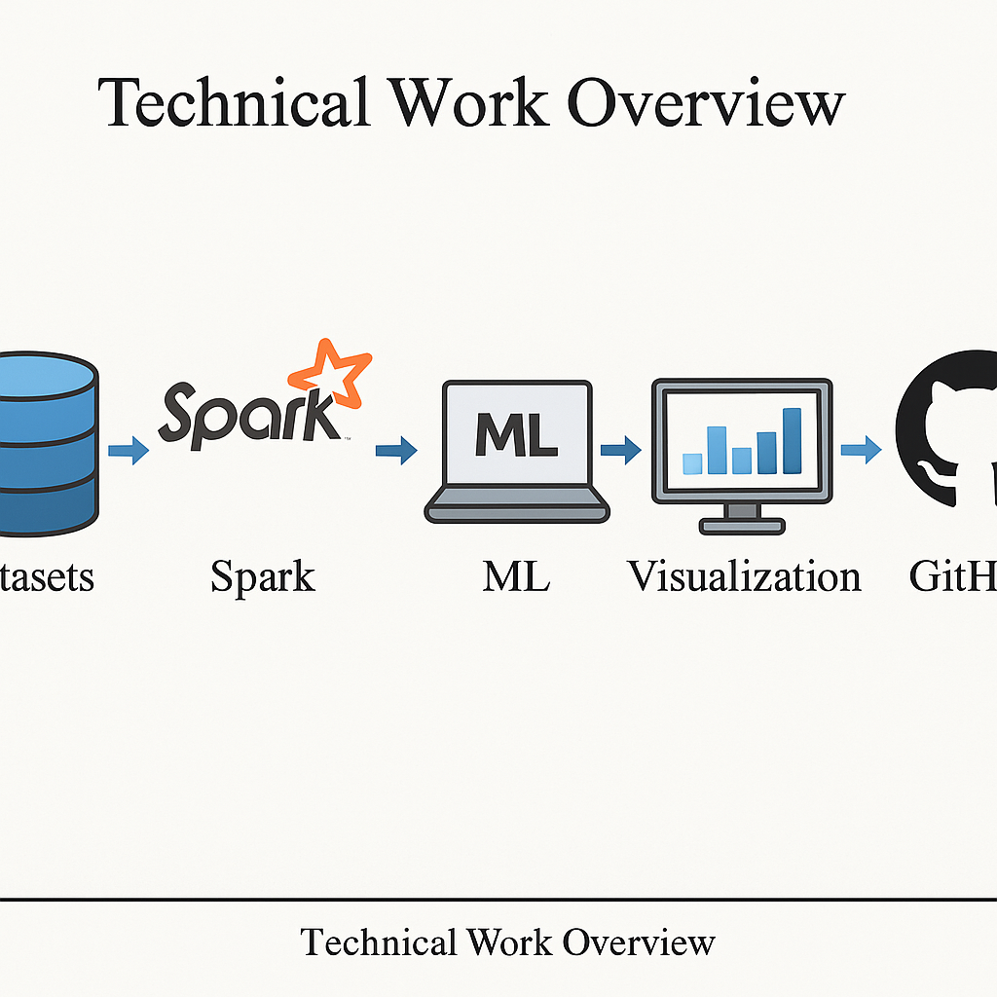
Technical Work Overview
• Spark-based ETL and exploratory data analysis (EDA) • Regression model training and evaluation with Spark MLlib • Generated 5+ bar, line, and map visualizations • Worked with 3 datasets, ran 4 Spark jobs • All code written in Colab notebook GitHub: GitHub URL Data: Accessed via AWS S3 (.parquet / .csv)

Slide 11
References
NYC Taxi & Limousine Commission. (2025). Yellow trip data. https://www.nyc.gov/site/tlc/about/tlc-trip-record-data.page
NYC Department of Transportation. (2025). Traffic volume counts. https://www.nyc.gov/html/dot/html/about/datafeeds.shtml
Apache Software Foundation. (2024). Apache Spark documentation. https://spark.apache.org/docs/latest/
Kumar, A. (2023). Big data analysis with PySpark. Packt Publishing.
Python Software Foundation. (2025). Matplotlib documentation. https://matplotlib.org/stable/index.html
Waskom, M. (2025). Seaborn: Statistical data visualization. https://seaborn.pydata.org/
Amazon Web Services. (2025). Amazon S3 documentation. https://docs.aws.amazon.com/s3/
GitHub Repository. (2025).

Slide 12


